Slide 1



Smart Resume Generator

Slide 2
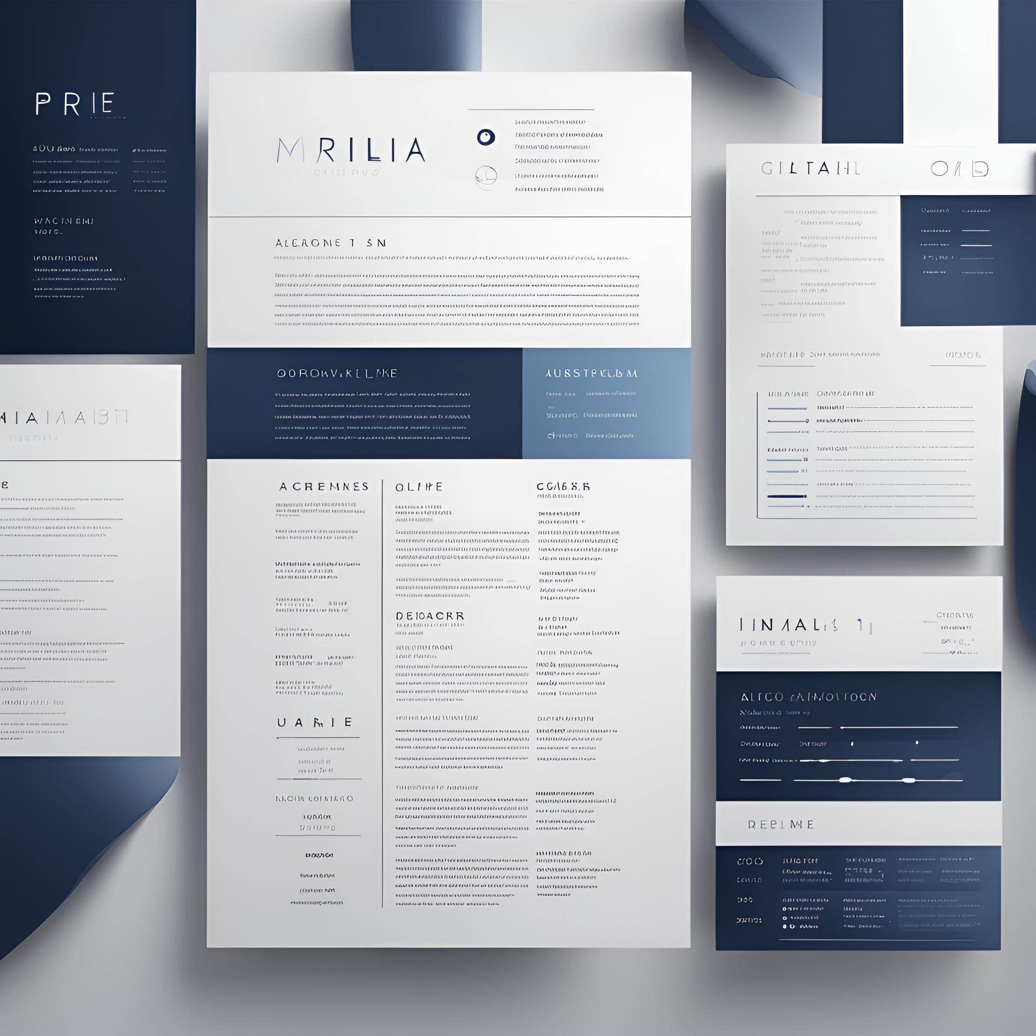

Introduction
The Smart Resume Generator is a web application designed to create professional resumes easily. Users can input their personal details, skills, and work experience to generate a resume in PDF format.

Slide 3
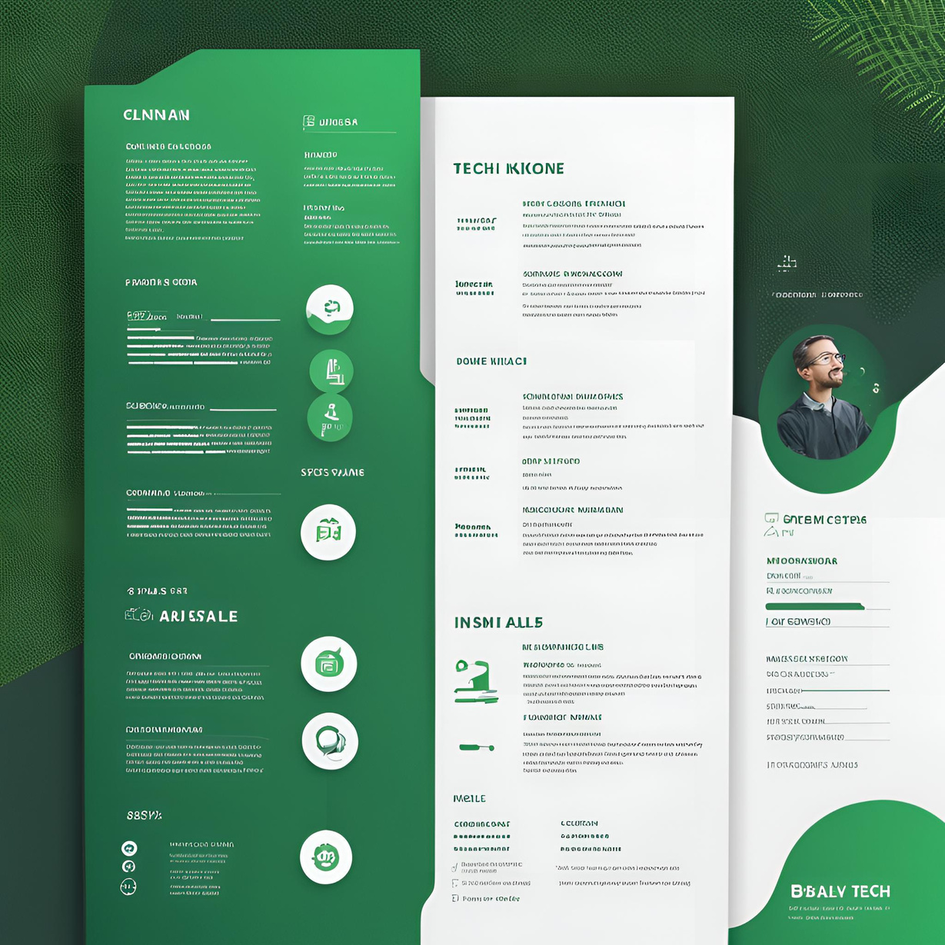

Tech Stack
HTML: Structure
CSS: Styling and Layout
JavaScript: Dynamic Functionality
Bootstrap: Responsive Design
jQuery: Simplified JavaScript Operations
jsPDF: PDF Generation

Slide 4



Integrity
HTML form, CSS styling, JavaScript for resume generation and download.
Project Structure
HTML: Form inputs for personal information
CSS: Styling with gradients, animations, and responsive design
JavaScript: Handles form data, generates resume, downloads PDF
Innovation
Innovative integration of HTML forms, CSS design, and JavaScript for dynamic resume creation and download.
Creativity
Creative blend of design, functionality, and interactivity for seamless user experience.

Slide 5


Key Features
Upload Profile Picture
Generate Resume with Personal Information
Download Resume as PDF

Slide 6

HTML Code Overview
Structure of the form with input fields
Buttons for generating and downloading resumes
Div for displaying the generated resume

Slide 7
CSS Code Overview

Slide 8


CSS Code Overview
Styling for layout, colors, and fonts
Responsive design using Bootstrap
Animations like fade-in effects

Slide 9
JavaScript Code Overview

Slide 10
JavaScript Code Overview
Handles form data submission
Generates resume dynamically
Converts resume to PDF using jsPDF

Slide 11
Live Demo
Demonstration of filling the form, generating the resume, and downloading it as a PDF.

Slide 12
Challenges & Solutions
Handling image uploads correctly
Ensuring proper PDF formatting
Responsive design adjustments

Slide 13

Conclusion
Learned about web technologies
Implemented dynamic PDF generation
Possible improvements: Adding templates and themes

Slide 14



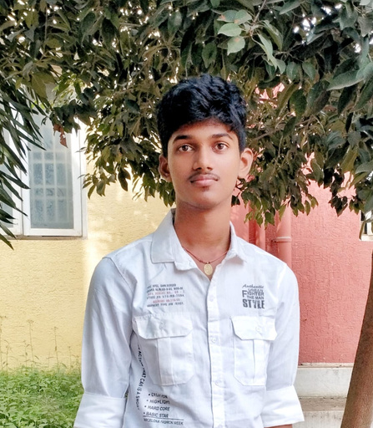


Our Team
Shaik Abdulla Afzal Khadri
K Bhargava Sai
K. Veera Vasatha Narayana
Panidapu Sri Charan
Parichuri Sri Ganesh

Slide 15


